Slide 1


Session 6:
Resources and Costs
Planning, Risks and Issues
Dr Andre Samuel

Slide 2


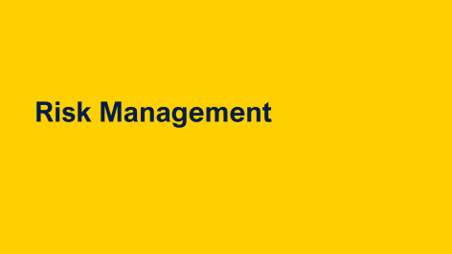
Learning Outcomes

Slide 3
Resource Planning

Slide 4



Project resourcing and related techniques
Once a project plan has been drafted (but not finalised), resources can be estimated and attached to the plan
This is a valuable exercise – evaluating at an early stage the potential impact of any resource constraints on a proposed schedule…
… and facilitate resource-based budgeting to develop a detailed “bottom up” budget for the entire project

Slide 5
What is meant by the term: ‘Resource’?
A project may have an excellent plan but this is of little use unless the plan can be carried out in practice
This leads us to consider the important question: Just what things do we need to carry out the project? (i.e. the resources required)
Quickly followed by quantifying:
How many of each thing do we need?
How much will they cost?
What is the overall total cost?
(the project budget)

Slide 6

Resource categorisation
There are generally four resource categories on every project:
Human Resources
Materials
Equipment
Cash (to meet specific subcontract commitments)
 Can you think of an example of each type?
Team &
Organisation

Slide 7
Resource Breakdown Structure
Resource breakdown structure - A hierarchical representation of resources by category and type (PMI, 2021, p. 187 and 247)
Resources
Human resources
Materials
Equipment
Cash
Project
Manager
Concrete
Server
Consultant fee
Project Team
Steel rods
Machinery
Subcontractor
fee
Etc.
Etc.
Consultant
Miscellaneous
Etc.
Etc.

Slide 8
Resources – key questions to ask?
Is the cost of each resource time-based or fixed?
How easy is to determine the cost accurately?
Has every project resource requirement been identified and quantified? Nothing missed?
Are the projected costs firm quotations or just estimated costs that may change?
Is there a need for contingency?
Have we made allowance for risks?

Slide 9
Resource Optimization
Two main types of schedules
  Resource limited
  Time limited
Resource Constrained - Levelling, allowing end date to move
Time Constrained – Smoothing, moving tasks
Splitting activities
Assigning replacement resources
Available
6 hrs
75%
Resource
Limited
Time
limited
6
5
4
3
2
1

Slide 10
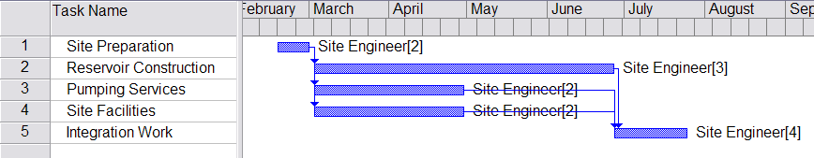
Resource levelling or “smoothing”
Consider the following simple construction project example:
Note that Task 2 (16w) is twice as long
as Tasks 3 and 4 (8 weeks). Task 1 is 2 weeks
and Task 5 is 4 weeks
 Where is the critical path?

Slide 11
Critical Path
Where is the critical path?

Slide 12
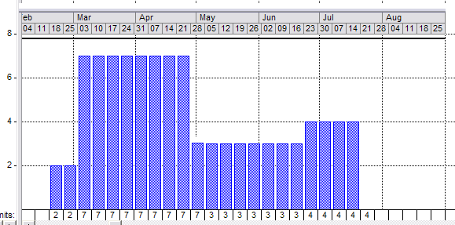
The resource histogram
(based on the previous schedule)
What is this profile indicating? Any evidence of potential staffing problems?

Slide 13
Smoothing and Levelling
Resource Levelling can be applied to projects when there are Resource Constraints. Resource Levelling forces the amount of work scheduled NOT to exceed the limits of the resources available. This results in either the activity durations being extended or entire activities being delayed to periods when the resource is available.
NB. This often results in longer project durations.
Smoothing is the process applied to a project to ensure that resources are used as efficiently as possible. It involves utilising float/slack within the project or increasing or decreasing the resource required for specific activities so that peaks and troughs of the resource
usage are ‘smoothed out’.
NB. Smoothing does not affect the end date of
the project duration

Slide 14
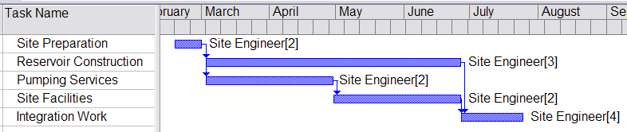
Resource levelling with permissible float
Site Facilities now rescheduled to follow Pumping Services – no effect on overall project duration but a resourcing benefit

Slide 15
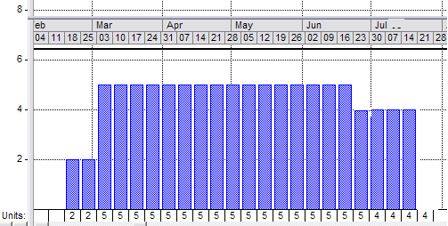
A smoother histogram
Resource profile for Site Engineers now much smoother - and easier to recruit/mobilise/manage

Slide 16
Warehouse Development Example
The Problems
1 Only one admin resource is available for the project and they are currently scheduled to do both Activity 3 and Activity 5 on Day 2 of the project.
2 Only two carpenters work for the organisation so clearly there is an over demand on Activity 6.
What actions can the Project Manager carry out to take these problems into consideration?

Slide 17
Smoothing
Smoothing out resources (duration not affected)
Some free slack/float – activity 5 moved to day 3

Slide 18
Levelling
Levelling resources (duration may be affected)
Resource limited – 2 Carpenters – extends the project time

Slide 19
Resource Costing

Slide 20
Cost categories
Time – Direct input of labour into tasks
Materials – consumables and other items using in the process
Capital equipment – the purchase of the means of providing the conversion process, or part of its cost, maintenance, running and depreciation offset against activities
Overheads – provision of an office, financial and legal support, managers and non-direct staff
Contingency – margin/allowance
(Maylor, 2017, pp. 178)

Slide 21




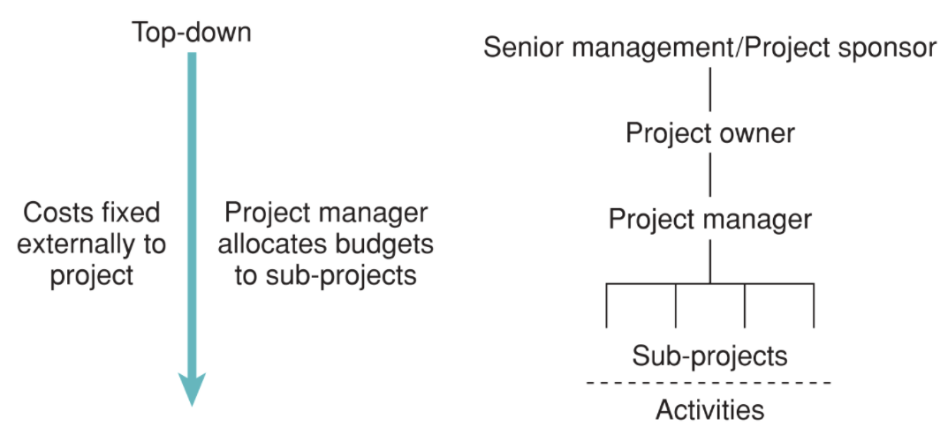
Budgeting: Top-Down….
Time
Quality
Cost
(week 6)
Scope
Plan Cost Management
Estimate Costs
Determine Budget
The Top Down approach:
Budgets are prepared by top management and imposed on the project manager
Top down budgets clearly express the business performance goals and expectations of top management
However top-down budgets can be unrealistic because they do not incorporate the specialist input and knowledge of the project staff who have to implement them.
(Maylor, 2017, pp. 177)

Slide 22
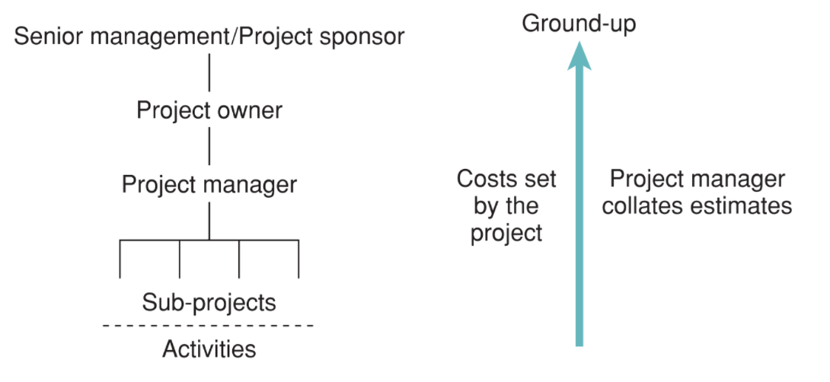
…or Bottom Up?
Time
Quality
Cost
(week 6)
Scope
Plan Cost Management
Estimate Costs
Determine Budget
The Bottom Up approach:
Project managers and planning/cost engineers prepare the budget based on a detailed analysis of all the resources required for the project tasks
Once prepared, the project budget is passed up the chain of command for review and approval
By definition bottom-up budgets tend to be more accurate and can have a positive impact on project morale because staff have played an active role in the budgeting process (rather than having a budget imposed on them from above)
(Maylor, 2017, pp. 177)

Slide 23
Project resourcing and budgeting
Once a project plan has been drafted (but not finalised), resources can be estimated and attached to the project tasks
The specific quantity of each resource must be defined and the market cost ascertained
Once this exercise is complete, managers can use resource-based budgeting to develop a detailed “bottom up” budget for the entire project.
This can be circulated amongst the team
- and often further savings and efficiencies
can be identified

Slide 24
Resource based budgeting
– process summary
A task-based project plan is assumed to have been drafted (if not finalised):
Identify all significant resources required for the project
Go through the project task by task and allocate the resources required for each task
Estimate the quantities required for each resource on each task (consider whether fixed or time-related – this matters!)
Determine the cost of each resource (fixed or time-related?)
Calculate total resource costs by task
Aggregate for the overall project budget

Slide 25
Simple single task example
System Training
10 days duration
IT services:
Total cost
EUR 500
2 Trainers
Required
@ EUR 1,800/day
each
Room hire in local
Hotel: EUR 300/day
Training materials
Required: total cost
EUR 1,200
 What is the total budget cost in Euros for this task?

Slide 26
Answer: Simple single task example
System Training
10 days duration
IT services:
Total cost
EUR 500
2 Trainers
Required
@ EUR 1,800/day
each
Room hire in local
Hotel: EUR 300/day
Training materials
Required: total cost
EUR 1,200
 What is the total budget cost in Euros for this task?
(2 * 1800 *10) + 1200 + (300 * 10) + 500 = €40,700

Slide 27
Some costs are related to the overall project (not a single task)
Bridge project
15 weeks duration
IT services:
total cost
£ 3500
Site accommodation
required
£ 500/week
Project Manager
Salary:
£ 4000/month
Vehicles required:
total fixed cost
£ 16,500
 What is the total budget cost for these resources?

Slide 28
Answer: Some costs are related to the overall project (not a single task)
Bridge project
15 weeks duration
IT services:
total cost
£ 3500
Site accommodation
required
£ 500/week
Project Manager
Salary:
£ 4000/month
Vehicles required:
total fixed cost
£ 16,500
 What is the total budget cost for these resources?
(500*15) + 16500 + (((4000*12)/52)*15) + 3500 = £41346.15

Slide 29
Project Procurement
All the resources needed for the project may not be within the Project Team or organization. Hence, there is a need for “identifying those deliverables and services that will be developed in-house, and those which will be purchased from external sources.” (PMI, 2021, p. 65)
Procurement can cover everything from material, capital equipment and supplies to solutions, labour and services. (PMI, 2021, p. 74)
Agreements between buyer and seller
Could be:
  Contract
  Service Level Agreement
  Memorandum Of Agreement
  Purchase Order
Consider the potential suppliers
Purchasing may be signed off by different authority in the organisation

Slide 30
Summary
Addressed the following aspects…
A range of resources may be required for a project – HR, materials, equipment and cash.
Resources impact time and cost. When resources may be limited may need to level a project, when time is limited may need to smooth resource usage.
Explain the difference between top-down budgeting
and bottom-up budgeting.
Explore how resourcing is integral to budgeting.
Consider types of procurement for a project.

Slide 31

BREAK
Take a 10 minute break, after the break…
Planning for Risks and Managing Deployment – managing issues

Slide 32
Risk Management

Slide 33
Fundamentals!
Everything we do carries risk
Project which break new ground attract many risks
Project risks can be predictable or completely unforeseeable

Slide 34
Risks can occur at any stage in a project
For very large projects it is necessary to appoint a Risk Manager, who develops and monitors a comprehensive Risk Strategy
Project Management Office is a logical place for the risk management function to reside

Slide 35
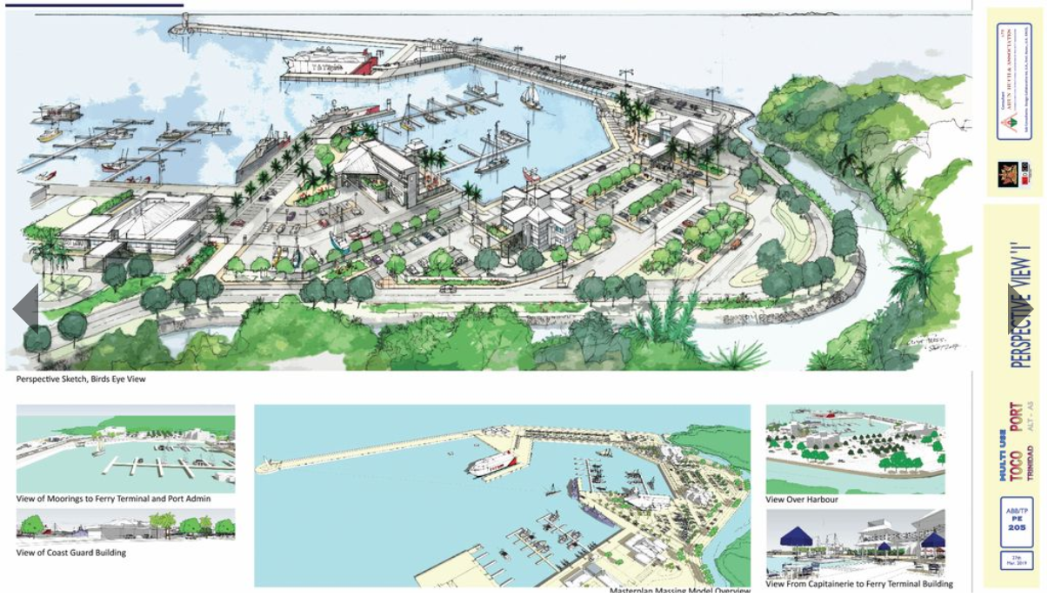
Trinidad- Toco Port
Source: Guardian (2019)

Slide 36
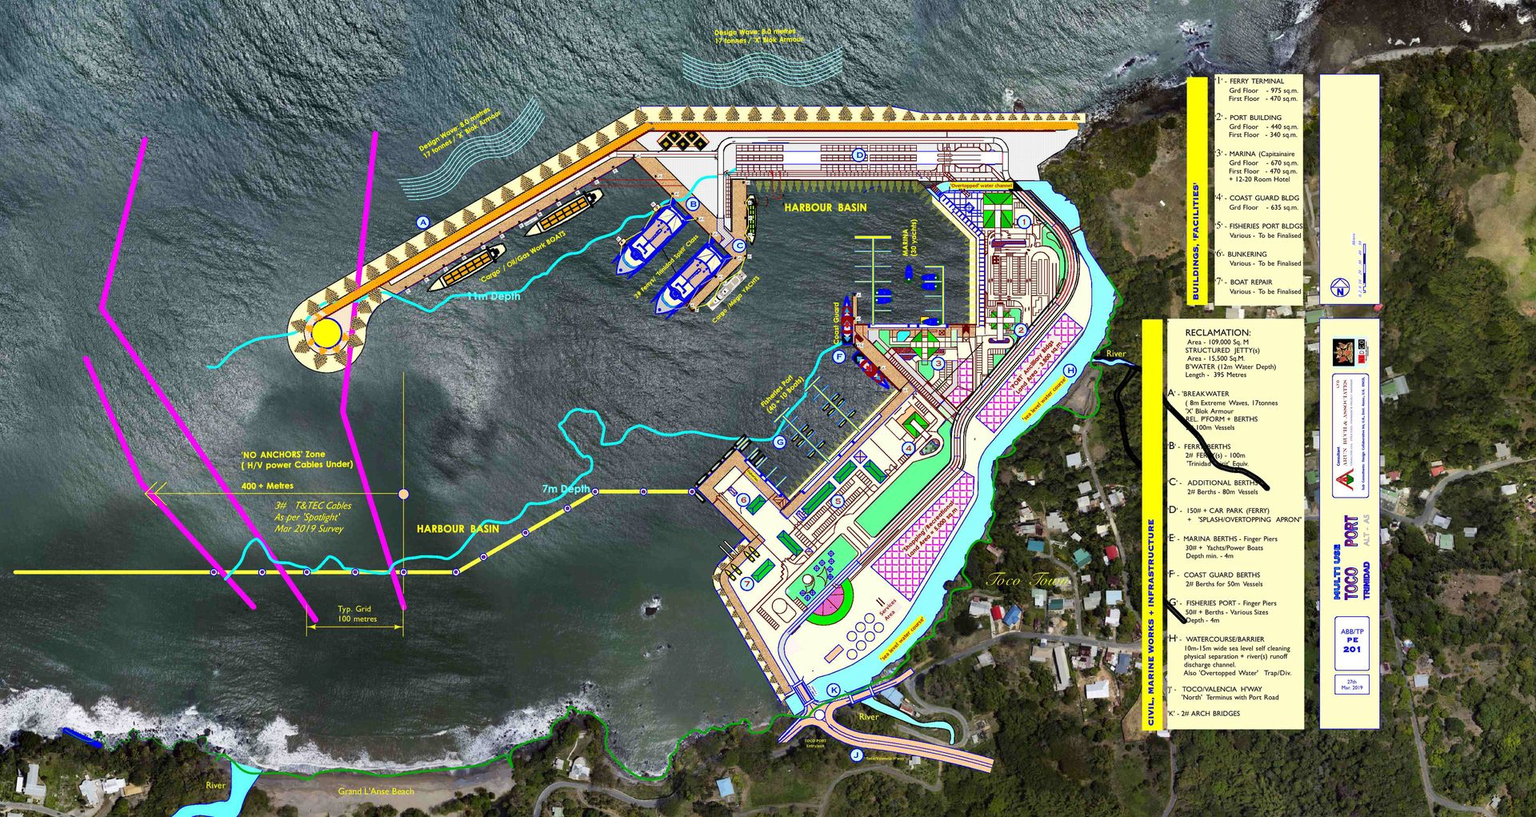
Trinidad- Toco Port
Source: Guardian (2020)

Slide 37
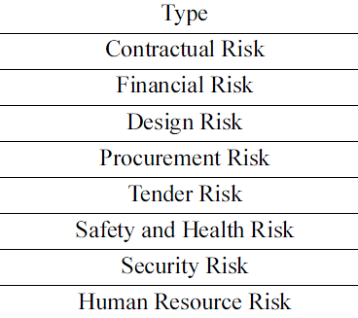
Types of Risks

Slide 38
Importance of Risk Management
Potential effects range from trivial inconvenience to project disaster
A risk event that occurs late in a project can be more costly than a similar event nearer the start of the project

Slide 39
Simply because as time passes there will be a greater value of work in progress and higher sunk costs at risk of loss or damage
We read in the newspaper about cost overruns and schedule slips on a wide variety of large scale development projects. Is it because of RISKS?

Slide 40
Project Risk and Issues Management: Overview
Risks can be identified at any time on the project
Risk management is a continual process of identifying, assessing, planning responses and implementing responses.
Risks are often assessed using impact and probability (likelihood) – the higher the impact and probability the more important the risk.
Issues are risks that have occurred. Sometimes they were predicted through risk management, sometimes not.
Issue management needs to be in place
to log the issue and how it was managed.

Slide 41


Planning for risks
                Pharmaceutical companies anticipated that there may be a drugs shortage cause by a No-Deal Brexit
                Drug companies started to stockpile drugs to be able to mitigate the risk of running out of medication
What happened?
              Different Issue
              Covid-19 happened first
              The stockpiling of drugs prevented a shortage in
              the UK

Slide 42
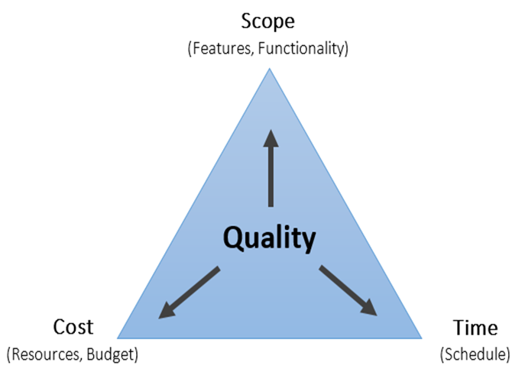
What is a Risk?
Project Risk is an uncertain event or condition
If it occurs, has a positive or negative effect
On one or more project objectives:

Slide 43
Risk Management on projects
All projects face risks of some nature
Risk "An uncertain event or condition that, if occurs, has a positive or negative effect on one or more project objectives.“ (PMI, 2021, p. 53, 117, 122 and 248)
Reminder – a risk can be positive, e.g. price reduction in the future on a project resource
Managing those risks in a professional manner is a key part of project management
Risk Appetite ”the degree of uncertainty an organisation or individual is willing to accept in anticipation of a reward" (PMI, 2021, p. 54 and 248)
Find a balance between being too risk averse and avoiding acceptable risks …
… but not being unnecessarily reckless and ignoring real risks that could jeopardise the success of the project

Slide 44
Risk Event and Trigger
For each risk a trigger must be documented.
The trigger identifies the risk symptoms or warning signs.
It indicates that a risk has occurred or is about to occur.
The risk trigger also gives an indication of when a certain risk is expected to occur

Slide 45
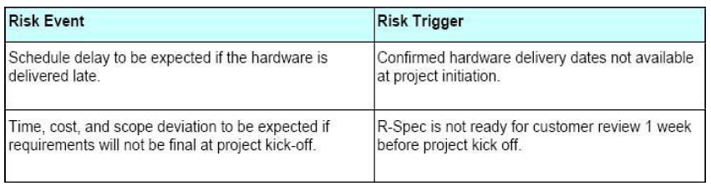
Example of Risk Triggers
"Because of the cause or condition that is true, a risk event may occur, having an effect on either a cost, quality, scope or time objective."

Slide 46
Primary Components for a Risk
A Probability (likelihood) of occurrence of the event
Impact of the event occurring (amount at stake)
Risk = f (Likelihood,Impact)
In general, as either the likelihood or impact increases, so does the risk

Slide 47
Risk Management Process
From beginning
Continual monitoring
Plan Risk Management
Implement Responses
Identify
Categories of risk and potential risks and document (register/log and RBS)
When/if risk becomes an issue
Formulate a response, document it
Response
Plans
Analyse Risks:
Quantitative Qualitative
Potential consequences, likelihood
Matrix commonly used

Slide 48
Risk identification
Risk identification should start as early as possible during the initial project phases and should be an ongoing part of planning activities.
One of the main objectives at this stage is to not only identify the risk but also capture the information available about the risk itself and wherever possible assess the likely impact the risk might have on the project.
Collect Risks through:
  Brainstorming with project team and experts – use Risk Breakdown Structure categories to guide the discussion
  Checklists - from past similar project, be sure to consider more areas
  Interviews – with project participants, stakeholders and subject matter experts
Results in a “Risk Register or Log” and/or Risk Breakdown Structure

Slide 49

Sources of Risk: Internal
Risk & Uncertainty
Adaptivity & Resilience
Maylor and Turner (2022, pp. 247) proposes these Key Project Risk Categories:
Health and safety
Legal
Also, you may want to consider: Resources
Time
Quality
Cost
Scope

Slide 50
External sources of risk:
Stakeholders and PESTLE
Risk & Uncertainty
Adaptivity & Resilience
Consider risks from Stakeholders
Consider Environmental Risks (PESTLE)
Political context, Consideration of influence upon Government policies, taxation changes, foreign trade regulations, political risk in foreign markets, changes in trade blocks (EU).
Economic context, Consideration of influence upon business cycles, interest rates, personal disposable income, exchange rates, unemployment rates, GDP trends.
Socio-cultural factor context, Consideration of influence upon population changes, income distribution, lifestyle changes, consumerism, changes in culture and fashion.

Slide 51
External sources of risk:
PESTLE continued
Risk & Uncertainty
Adaptivity & Resilience
Technological context, Consideration of influence upon new discoveries and technology developments, ICT innovations, rates of obsolescence, increased spending on R&D.
Environmental context, Consideration of influence upon environmental protection regulations, energy consumption, global warming, waste disposal and re-cycling.
Legal context, Consideration of influence upon competition laws, health and safety laws, employment laws, licensing laws, IPR laws.

Slide 52
Risk Categorisation:
Risk breakdown structure
RBS Level 0 | RBS Level 1 | RBS Level 2
0. ALL SOURCES OF PROJECT RISK | 1. Technical Risk | 1.1 Scope Definition
 |  | 1.2 Requirements definitions
 |  | 1.3 Estimates, assumptions and constraints
 |  | 1.4 Technical processes
 |  | 1.5 Technology
 |  | 1.6 Technical interfaces
 |  | Etc.
 | 2. Management Risk | 2.1 Project management
 |  | 2.2 Program/portfolio management
 |  | 2.3 Operations management
 |  | 2.4 Organisation
 |  | 2.5 Resourcing
 |  | 2.6 Communication
 |  | Etc.
Risk breakdown structure - A hierarchical representation of potential sources of risks (PMI, 2021 p. 87 and 248)
Risk categories
Extract from PMI (2017, pp. 406)

Slide 53
Risk breakdown structure, contd.
RBS Level 0 | RBS Level 1 | RBS Level 2
0. ALL SOURCES OF PROJECT RISK | 3. Commercial Risk | 3.1 Contractual terms and conditions
 |  | 3.2 Internal procurement
 |  | 3.3 Suppliers and vendors
 |  | 3.4 Subcontracts
 |  | 3.5 Client/customer stability
 |  | 3.6 Partnerships and joint ventures
 |  | Etc.
 | 4. External Risk | 4.1 Legislation
 |  | 4.2 Exchange rates
 |  | 4.3 Site/facilities
 |  | 4.4 Environmental/weather
 |  | 4.5 Competition
 |  | 4.6 Regulatory
 |  | Etc.
Extract from PMI (2017, pp. 406)

Slide 54
The risk register/log
This project document must be updated with any new risks as and when they are identified. The risk log provides a key point of control during the lifetime of the project.
Risk ID | Description | Date Raised | Author | Owner | Probability | Impact | Proximity | Response | Status | Date Closed

Slide 55
Quantitative Risk Analysis
Range of techniques
Expected value:
  Likelihood * Cost of occurrence
  Focus is on cost
Monte Carlo computer modelling
  Can be used for time, cost and other factors
Programme Evaluation and Review Technique (PERT)
  Uses realistic, optimistic and pessimistic times
  Focuses on the risk of project task estimations being inaccurate

Slide 56
Qualitative Risk Analysis
Risk impact Matrix
The closer a risk gets to this corner, the more important it becomes
Probability
Impact

Slide 57
Risk Impact Matrix
Needs careful thought to achieve balance between simplicity and effectiveness
Remember – it’s opinion based, not an exact science
Assessment of potential impact of risk:
Simple H/M/L or a 5 point scale
Assessment of likelihood of risk:
H/M/L or 5 point scale
The granularity chosen determines the number of cells in matrix

Slide 58
Threat Strategies
(PMI, 2021, p.123)
STRATEGY | DEFINITION
ESCALATE: | Escalation is appropriate when the project team or project sponsor agrees that a threat is outside the scope of the project or that the proposed response would exceed the project manager's authority.
AVOID: | When the project team acts to eliminate the threat or protect the project from its impact.
TRANSFER: | Transfer involves shifting ownership of a threat to a third party to manage the risk and to bear the impact if the threat occurs.
MITIGATE: | Action is taken to reduce the probability of occurrence and/or the impact of a threat. Early mitigation is usually more effective.
ACCEPT: | Acknowledge the existence of a threat, but no proactive action is taken.
Notes:
Escalate - Escalate to program level, portfolio level or other relevant part of the organisation.
Change the project plan or objectives, isolate the project objectives fro risk's impact, e.g. extend schedule, change strategy, reduce scope.
Responses to managing risks can generally be categorised as follows:
Tolerate – accept the risk without any immediate action
Treat – implement actions to reduce the impact and/or probability of risk occuring
Terminate – completely cease any project activities that could result in the risk
Transfer – transfer the risk to another party e.g. insurance policies, contractors
Take the risk – implies a positive risk where the rewards are considered to be worth the risk
Terminology
Contingency – Is the planned allotment of time and cost or other resources for unforeseeable risks within a project.
Contingency Plan – Alternative course(s) of action to cope with project risks or if expected results fail to materialise.
The selected response to a risk and whether contingency is needed will depend on a number of factors.

Slide 59
Opportunity Strategies
(PMI, 2021, p. 125)
STRATEGY | DEFINITION
ESCALATE: | Escalation is appropriate when the project team or project sponsor agrees that the oopportunity is outside the scope of the project or that the proposed response would exceed the project manager's authority.
EXPLOIT: | Exploit strategy may be selected for high-priority opportunities where the organization wants to ensure that an opportunity occurs/
SHARE: | Involves allocating ownership of an opportunity to a third party so who is best able to capture the benefit of that opportunity.
ENHANCE: | The project team acts to increase the probability of occurrence and/or impact of an opportunity. Early enhancement is usually more effective.
ACCEPT: | Accepting an opportunity acknowledges its existence, but no proactive action is taken.
Notes:
Risk avoidance is
Change the project plan or objectives, isolate the project objectives fro risk's impact, e.g. extend schedule, change strategy, reduce scope.
Responses to managing risks can generally be categorised as follows:
Tolerate – accept the risk without any immediate action
Treat – implement actions to reduce the impact and/or probability of risk occuring
Terminate – completely cease any project activities that could result in the risk
Transfer – transfer the risk to another party e.g. insurance policies, contractors
Take the risk – implies a positive risk where the rewards are considered to be worth the risk
Terminology
Contingency – Is the planned allotment of time and cost or other resources for unforeseeable risks within a project.
Contingency Plan – Alternative course(s) of action to cope with project risks or if expected results fail to materialise.
The selected response to a risk and whether contingency is needed will depend on a number of factors.

Slide 60
Implement Responses
Risks and Issues
Risk "An uncertain event or condition that, if occurs, has a positive or negative effect on one or more project objectives.” (PMI, 2021, p. 53, 117, 122 and 248)
⬇
Issue: “A current condition or situation that may have an impact on the project objectives” (PMI, 2021, p. 185 and 241)
Managed in a similar way….

Slide 61
Issues management
Identification
Resolve and Close
Record in Issues Register / Log
Yes / No Take action to
address the
issue
Monitor / Report
Escalate

Slide 62
Issues Log/Register
Issue log “is used to record and monitor information on active issues” (PMI, 2021, p. 185 and p.241)
All logged, example:
Issue ID | Issue Description | Date Raised | Actions | Owner | Status | Date Closed

Slide 63
Summary
Addressed the following aspects…
Identifying risks happens at the beginning and throughout the project (part of Planning and Deployment)
Risk management involves identifying, analysing, planning responses and implementing responses.
Risk matrix are commonly used to plot risks based on impact and probability (likelihood) – the higher the impact and probability the more important the risk.
Issues are risks that have occurred – not always something identified in risk management.
Issue management needs to be in place to log the issue and how it was managed.

Slide 64
Self-study activities
Priority: revise for the mid-term test
Read Chapter 10: Risk and Opportunities Management of Maylor (Kortext)
Work on your part 2b and 2c
Have a go at the practice quiz
Use the Project Libre videos, as required

Slide 65
Any questions
?
?
?
?
?
?
?

